Slide 1
Agenda
DataFrame study (contd.)
CXL recap & path forward

Slide 2
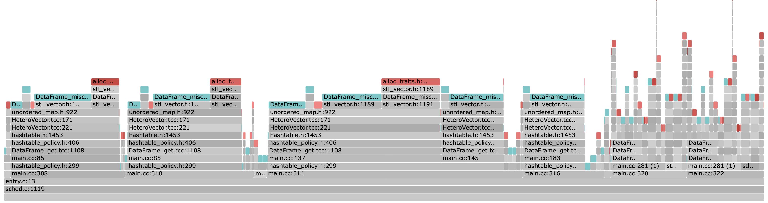
DataFrame Fault Graph
Includes first-time faults too, non-localized
(at 10% local memory – for all the analysis here and after)

Slide 3
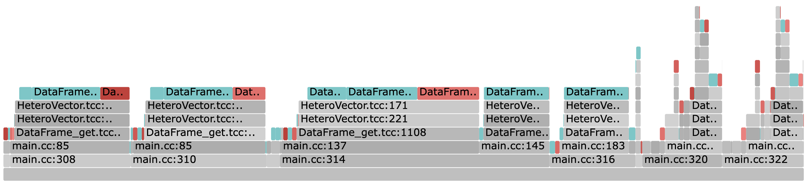
DataFrame Fault Graph
Localized to the benchmark and the library

Slide 4
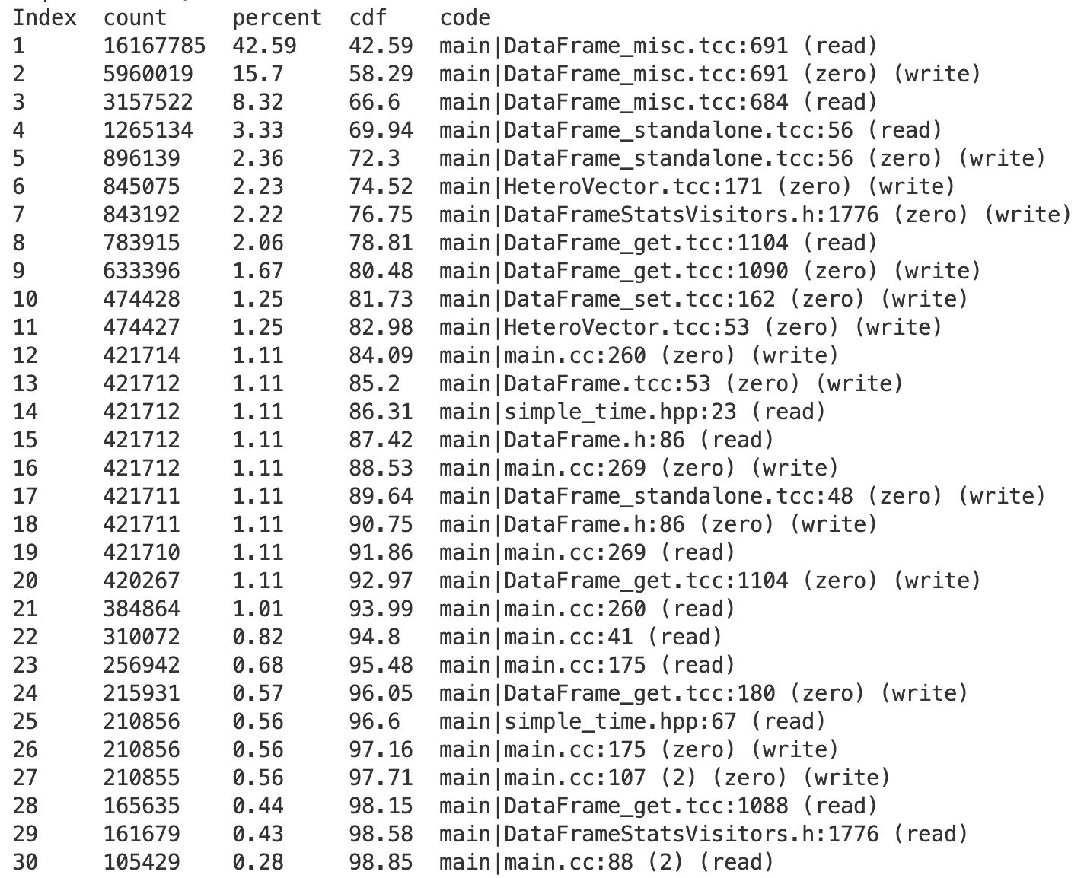
DataFrame stats
24 23 locations for 95%
Top 3 locations cover ~66%
13 first-time faulting locations (out of 22)

Slide 5
Hinting experience: Summary
Started off with basic hints
Got to ~92% fault coverage with ~25 hints (not all top 25)
Some first-time faults were challenging (example shortly)
Remaining 8% was still hurting TODO: numbers!
Turned-off demand paging for small-ish allocations
Got rid of the long tail of first-time locations
>97% coverage (reported in the paper)
More analysis needed
Turn iterating hints into sequential or range hints
Add Read-Ahead

Slide 6
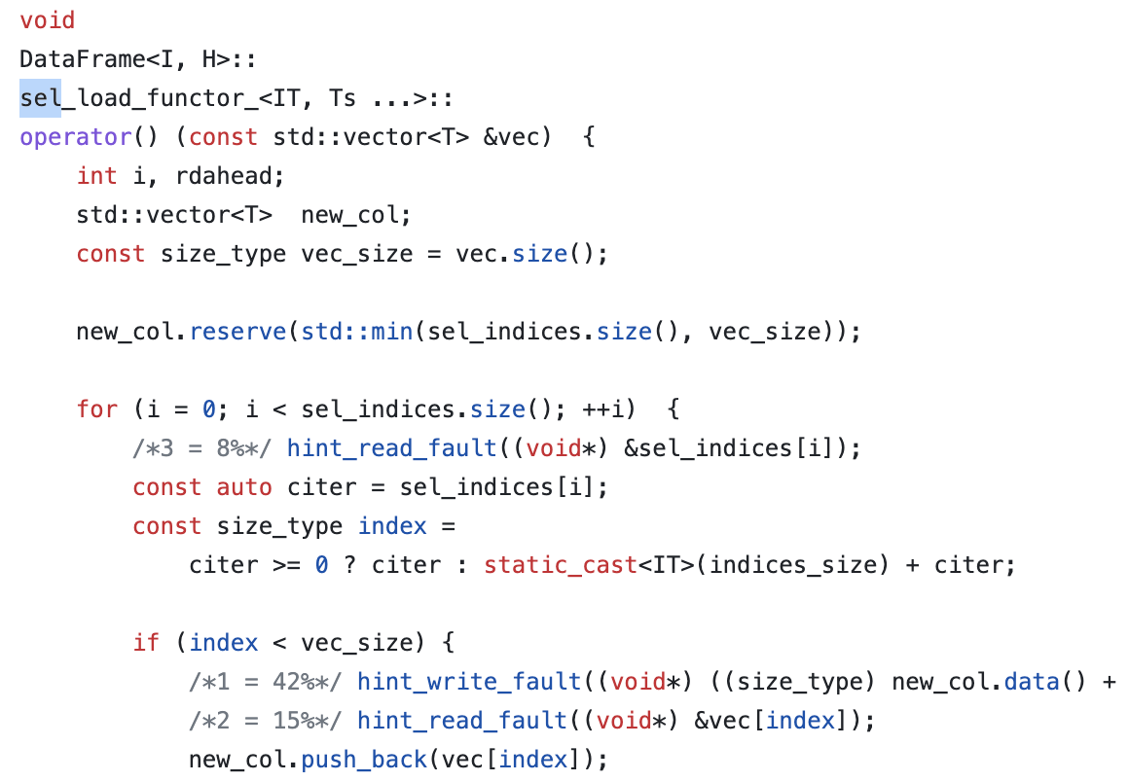
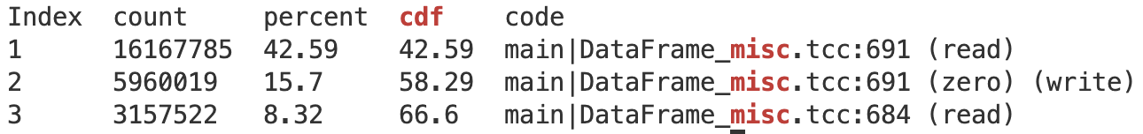
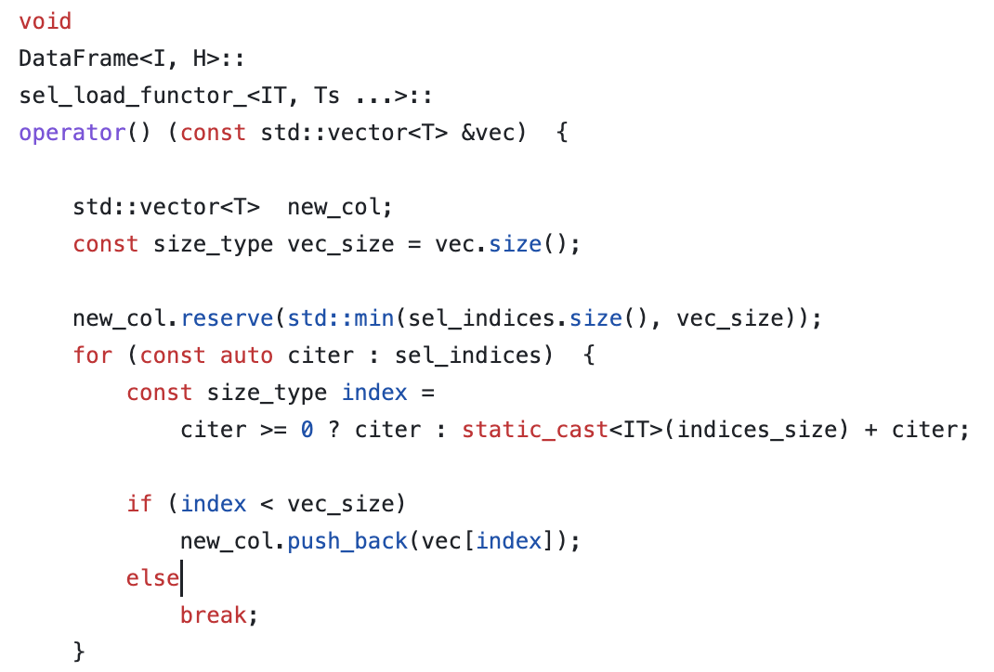
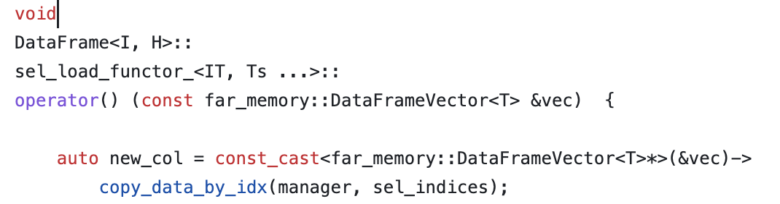
Hotspot 1: Select (66%)
Eden hints
Original
AIFM Copy Offload

Slide 7
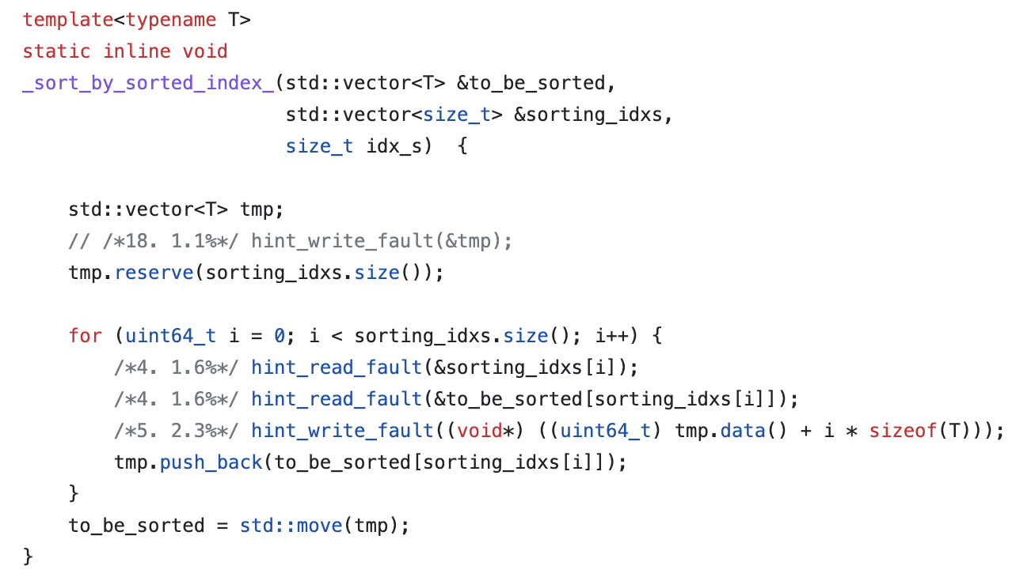
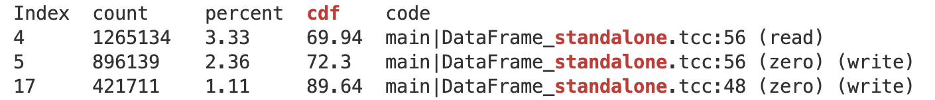
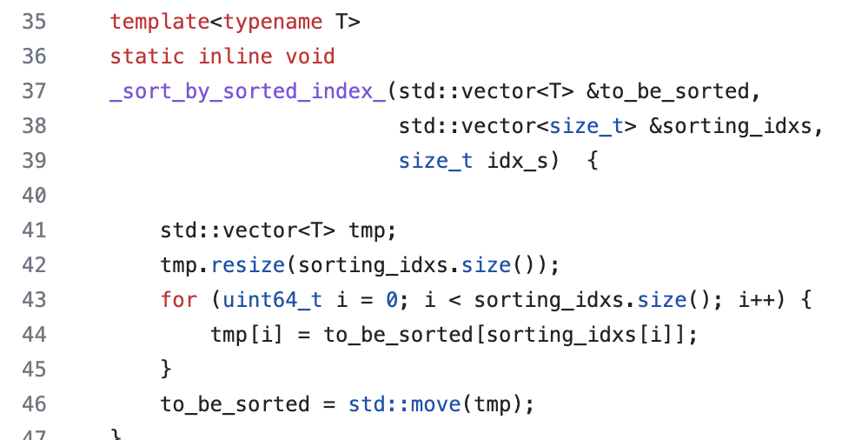
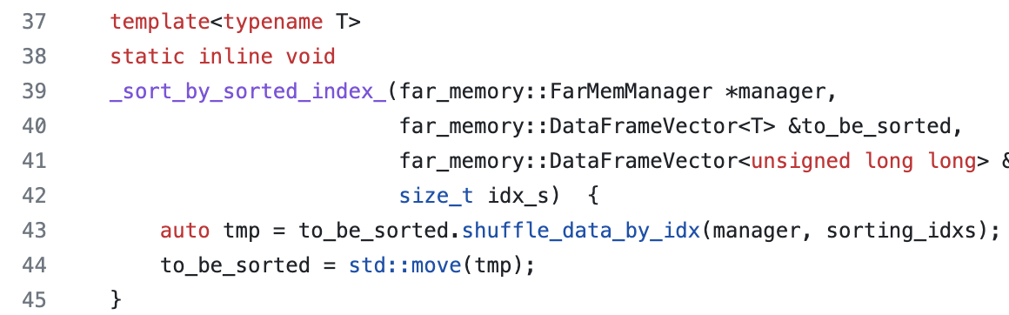
Hotspot 2: Shuffle (~7%)
Eden hints
Original
AIFM Shuffle Offload

Slide 8
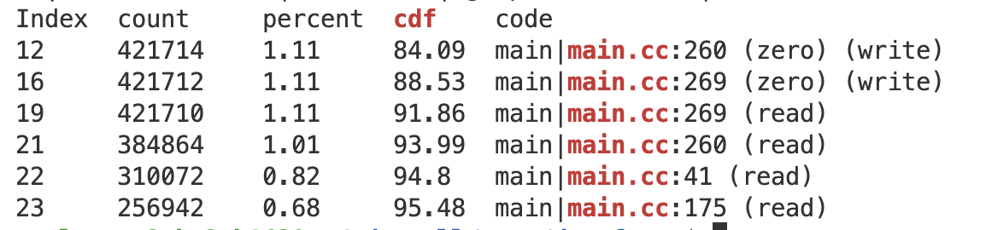
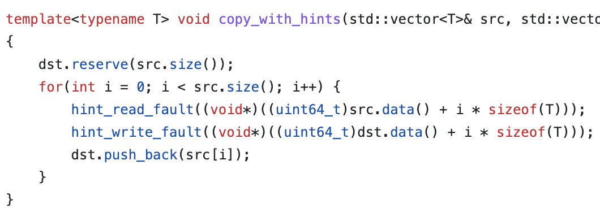
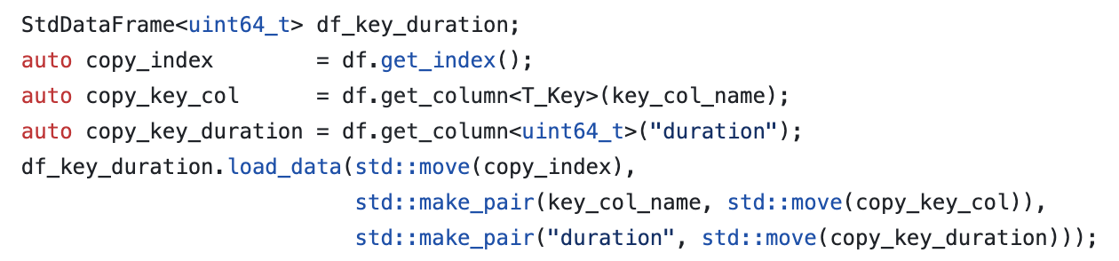
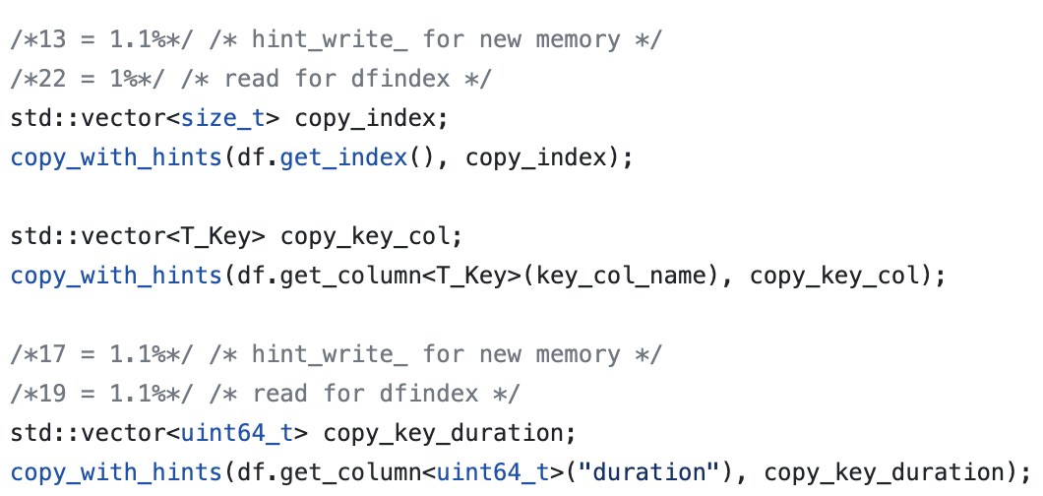
Hotspot 3: Copying in the benchmark (~5%)
An example of default copy constructor usage where hinting first-time write faults is not possible
One option: explicit copy which allows hints
Alternative 1: Use custom vector and overload the constructor (e.g., AIFM)
Alternative: Use range fault to bring in the source vector and turn-off first-time faults
Eden hints

Slide 9
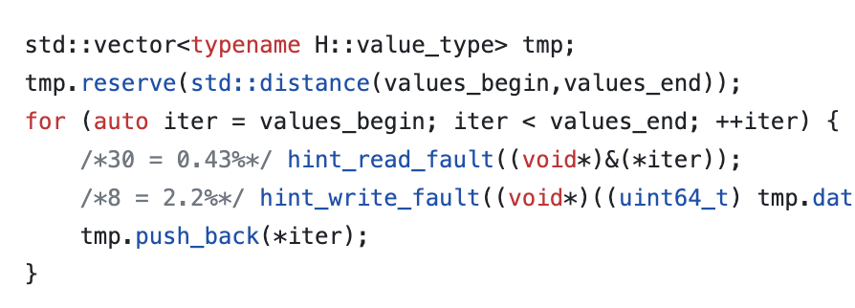
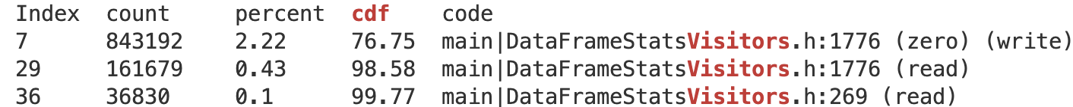
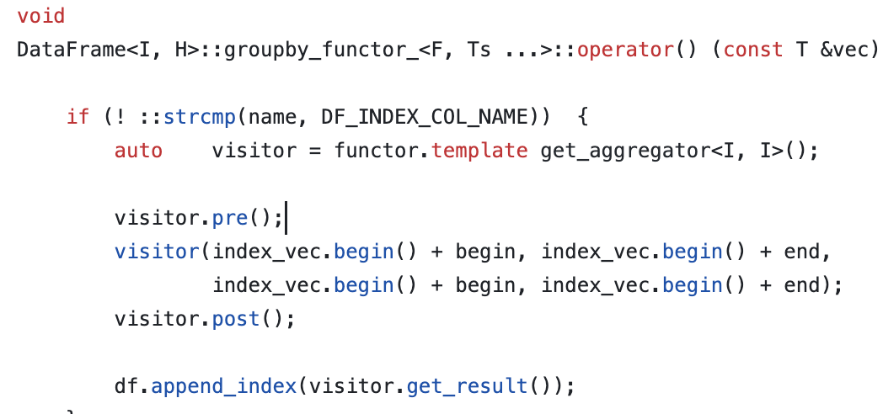
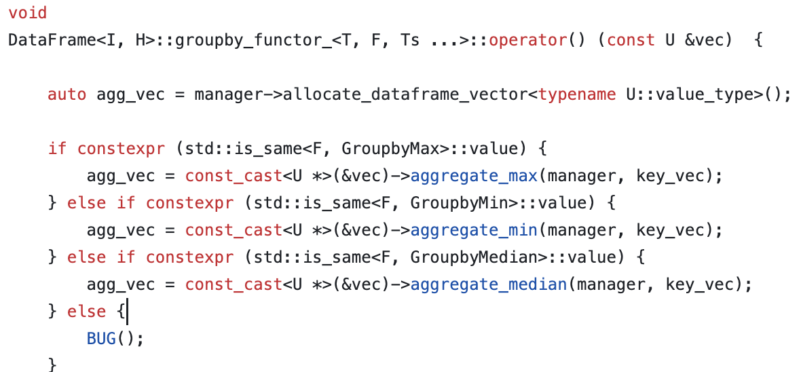
Hotspot 4: Aggregate (~3%)
Eden hints in median()
AIFM Aggregate Offload

Slide 10
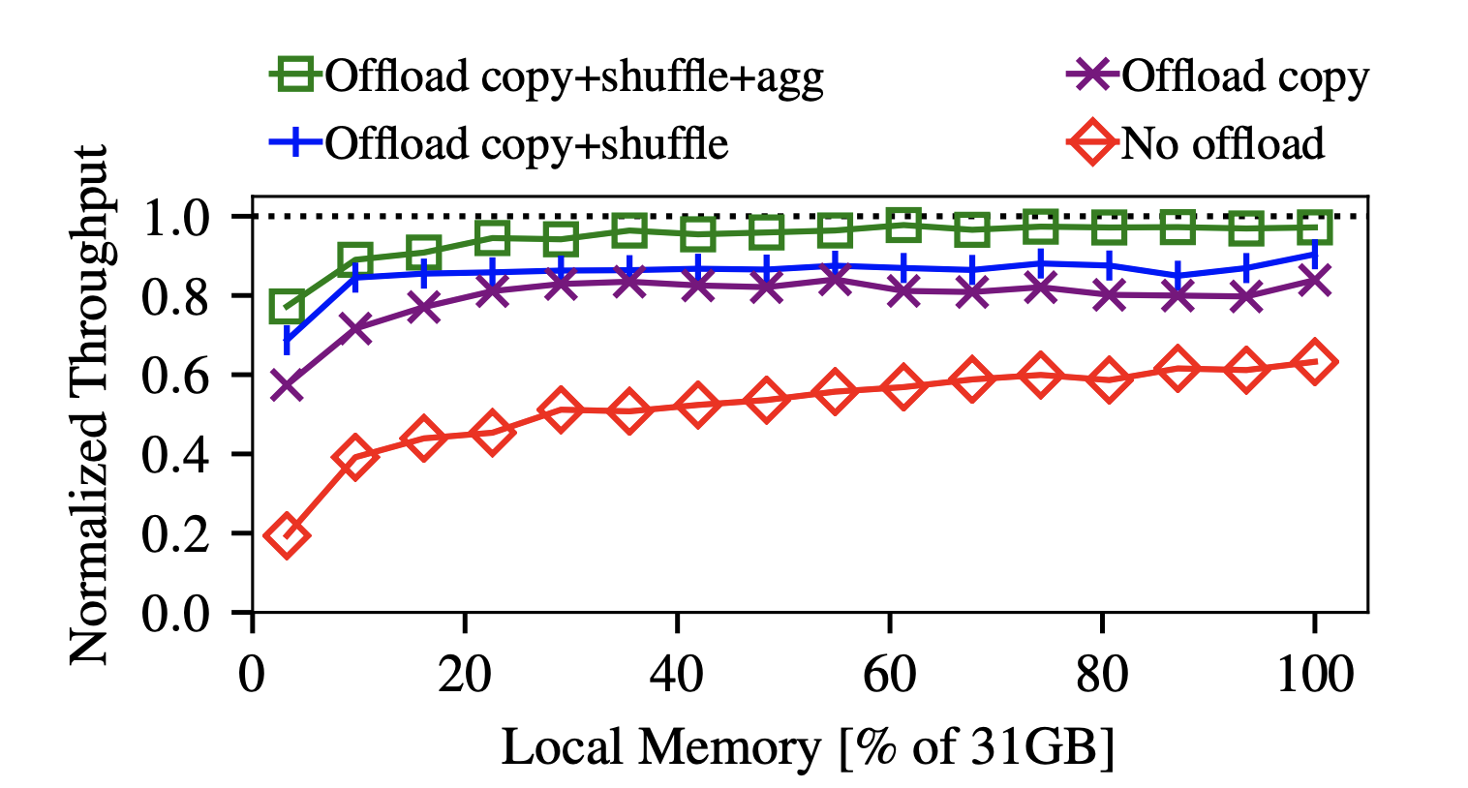
AIFM’s offloads
Note: We don’t compare to the offloaded version
Impact of offloads agree with their fault intensity
Maybe even CPU intensity?
These offload CPU cycles too – wonder why the norm perf doesn’t go above 1 though…
@Amy: Good candidates for copy acceleration?

Slide 11
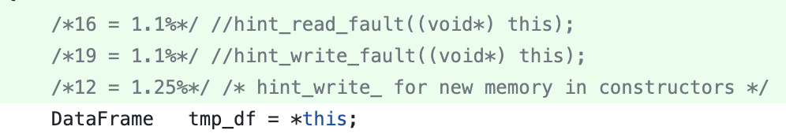
Hinting first-time faults
Copy constructor example
AIFM overloads the copy constructor and operator=()
We can do that too, but this requires data structure changes
Maybe many of them e.g., Vector, Dataframe, etc.
What about the stl ones?

Slide 12
Pre-faulting
for all allocations up to certain size
Allocates all the new pages before application touches them
mmap() POPULATE and madvise() POPULATE to explicitly prefault
Issues:
Redundant page allocations that may bloat memory usage and pollute local memory
We won’t be able to use extended hints
But on the good side:
The tail of first-time locations could vanish! (I commented out all but one write hints!)
Batching first-time page faults: entire allocation (e.g., 100MB) in one go

Slide 13
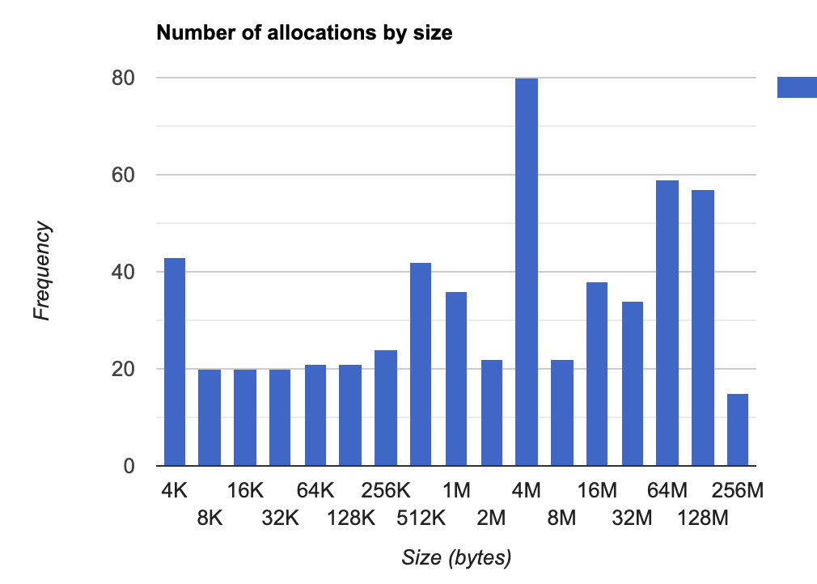
For Dataframe
Collected stats on allocation sizes
Used 128 MB as a cut-off
Smallest local memory setting was 1.5 GB
One write fault hint (of the top 3) was enough to remove all first-time faults and didn’t notice any memory bloating – so worked well for Dataframe
So is it a hack or a nice app-specific feature that Eden can support?

Slide 14
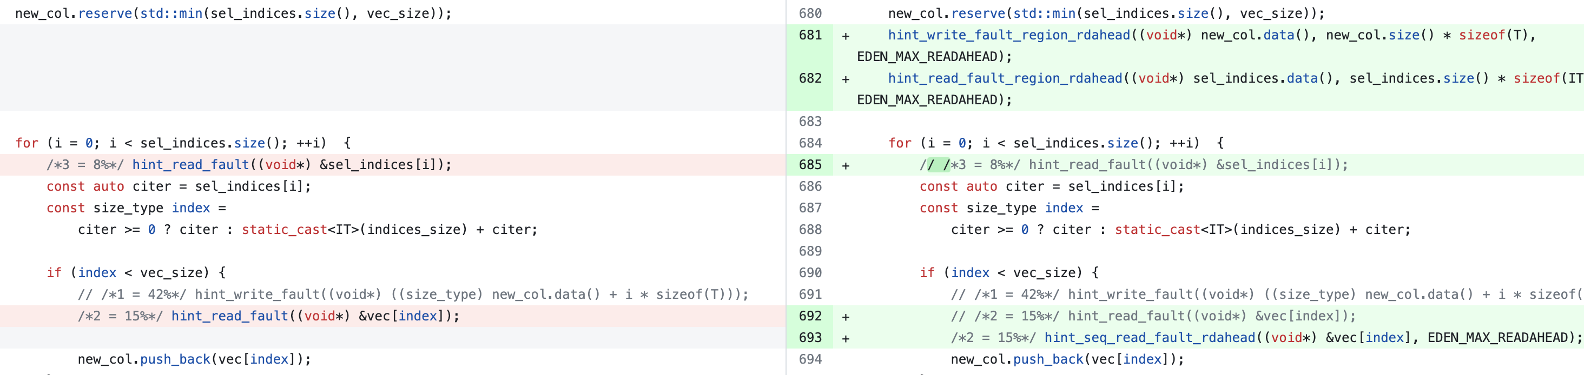
Sequential or range hints
Bring entire vector in one go (range hint out of the loop)
Or, set sequential flag to reduce hinting overhead
Both can take read-ahead – huge impact from batching

Slide 15
TODO Dataframe
Categorize effort by hints v. faulting lines of code

Slide 16
CXL recap
Hinting-guided CXL-based memory tiering
Premise: Static information can help alleviate dynamic access sampling + policy overheads in runtime e.g.
Prefetching next cache-lines in a page at a page-faulting location
Memory allocation or migration hints to move memory between tiers
Hinting interface/locations inspired by Eden but could be very different
Where do I start? Studying apps with CXL-like memory
Remote NUMA socket to emulate CXL memory
Identifying applications where we can help, and by how much?

Slide 17
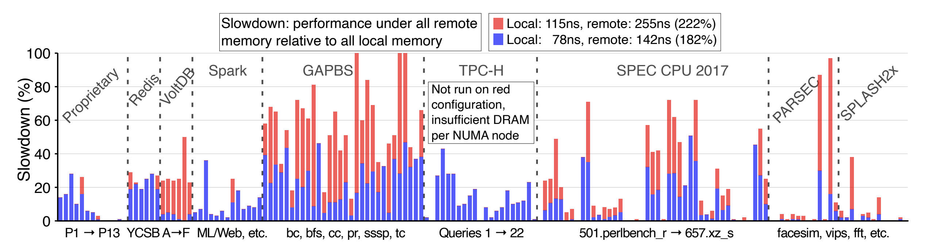
Pond: Latency-sensitivity study
Slowdown generally doubles when remote latency goes from 1.8x to 2.2x.
How would it look at, say, 5x? Is there a good way to estimate?
Should we be worrying about bandwidth sensitivity too?

Slide 18
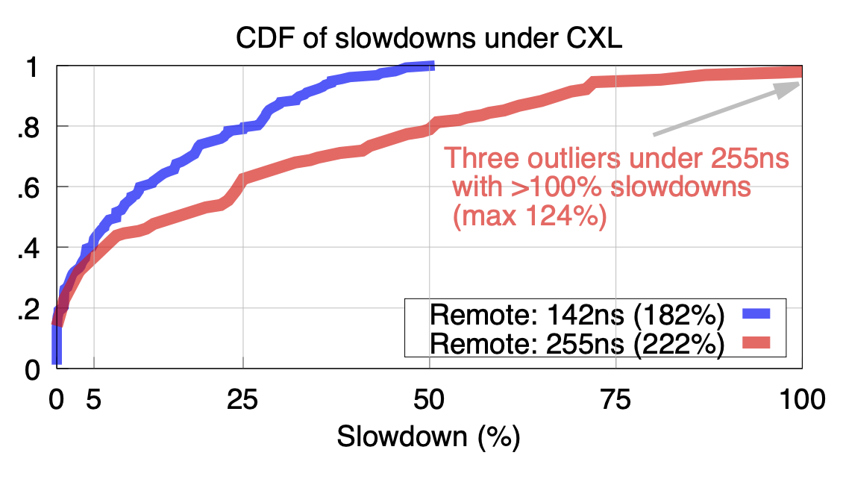
Pond: Latency-sensitivity study

Slide 19
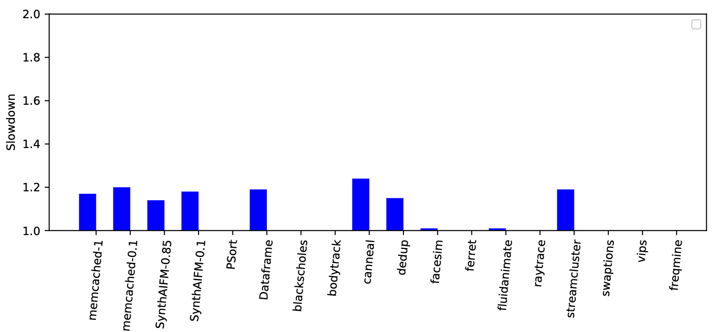
Similar chart for our apps
From Intel MLC tool
From Intel MLC tool
Local: 95 ns / 89 GBps
Remote: 145 ns / 34 GBps (152%)
Local: 89 ns / 65 GBps
Remote: 153 ns / 31 GBps (171%)

Slide 20
Next
How do I get sensitivity for various latency / bandwidth scenarios?
Get some more apps used in Pond
Look closely at one app: Memcached
Intel PIN tool?

Slide 21
Misc

Slide 22
CXL emulator + runtime
First step to get experiments going
Emulation with a CPU-less NUMA node seems fine
Need Library/runtime with basic tiering mechanisms
Key: page allocation and migration among tiers (i.e., nodes)
Found Intel memkind, flexmalloc, etc. but these only do allocations
We can also build anew on Eden

Slide 23
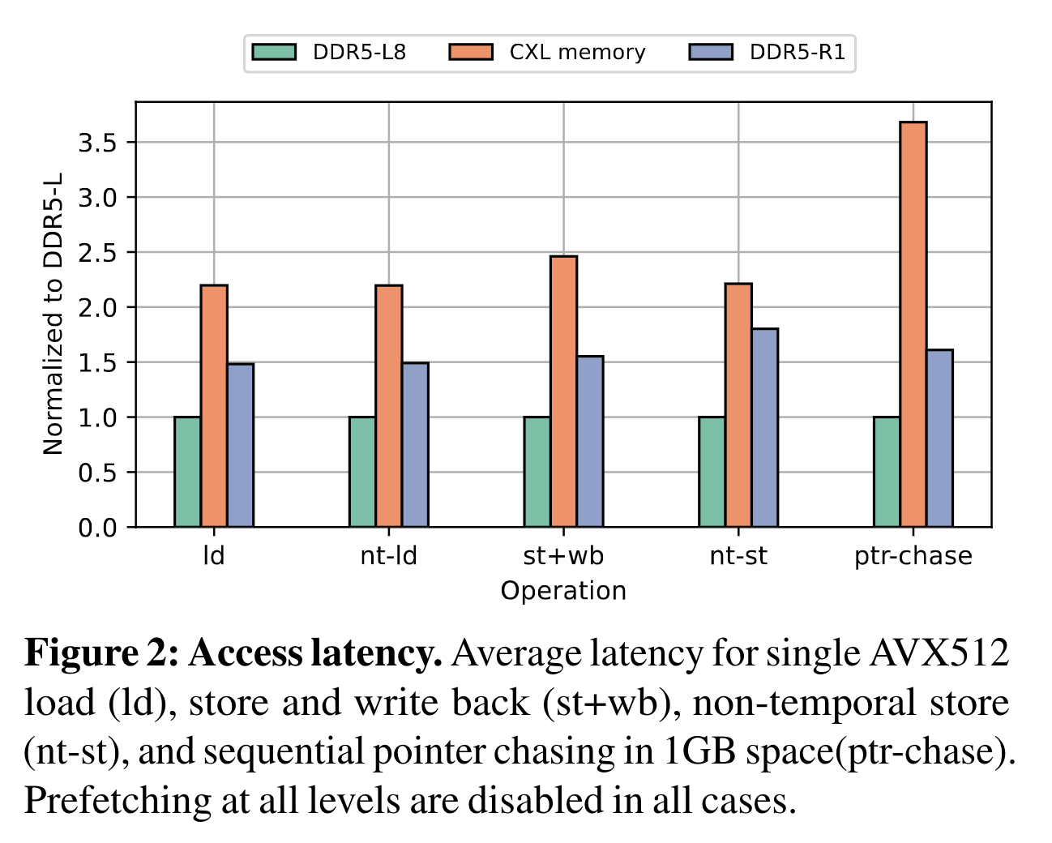
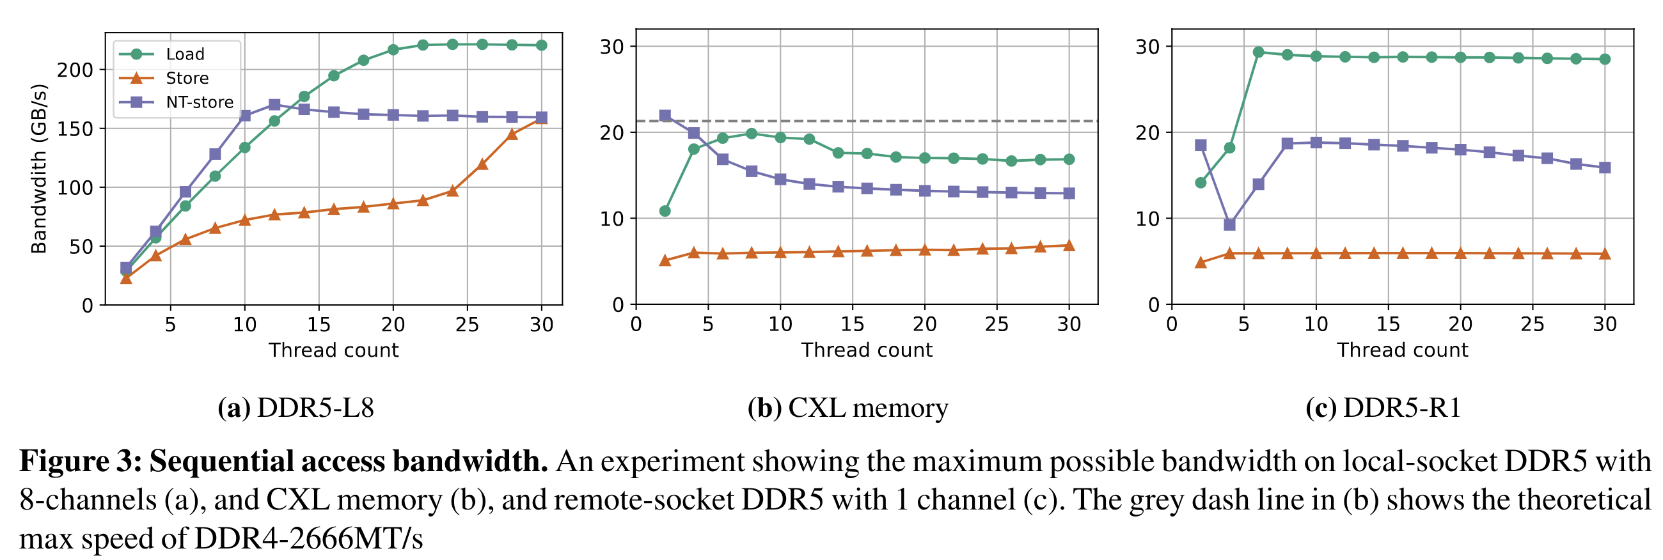
CXL emulation
With remote NUMA socket seems ok!
Latency emulation may be off by ~2x
Bandwidth is not hugely different (at least for single channel)
Source: Demystifying CXL Memory with Genuine CXL-Ready Systems and Devices, arXiv

Slide 24
Requirements for Tiering
Directing allocations
Libnuma provides explicit numa alloc/frees but page-granular
Intel memkind uses jemalloc and forwards allocations to different nodes either transparently or through custom API
When transparent, you specify policy e.g., node ratios
Either way, allocations stay put
We can already do this in Eden
Both these do not know what memory is faulted in at any point
Required for migration
Tracking possible with userfaultfd (UFFD_COPY to specified NUMA node) but it is better to avoid userfaultfd

Slide 25
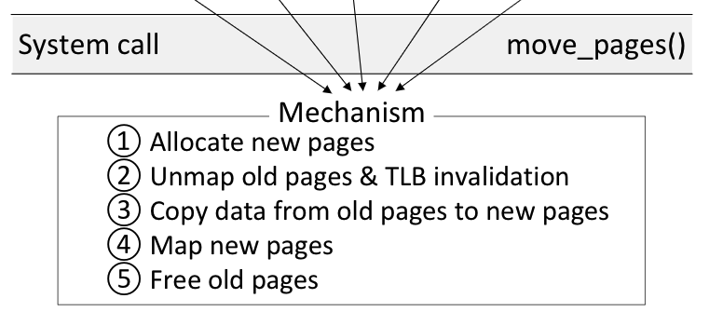
Requirements for Tiering
Page migration
move_pages() migrates pages among nodes (in batches)
Nimble’s improvements to the above sycall (open-sourced!)
Nimble also adds a new syscall: exchange_pages() which speeds up bi-directional movement

Slide 26
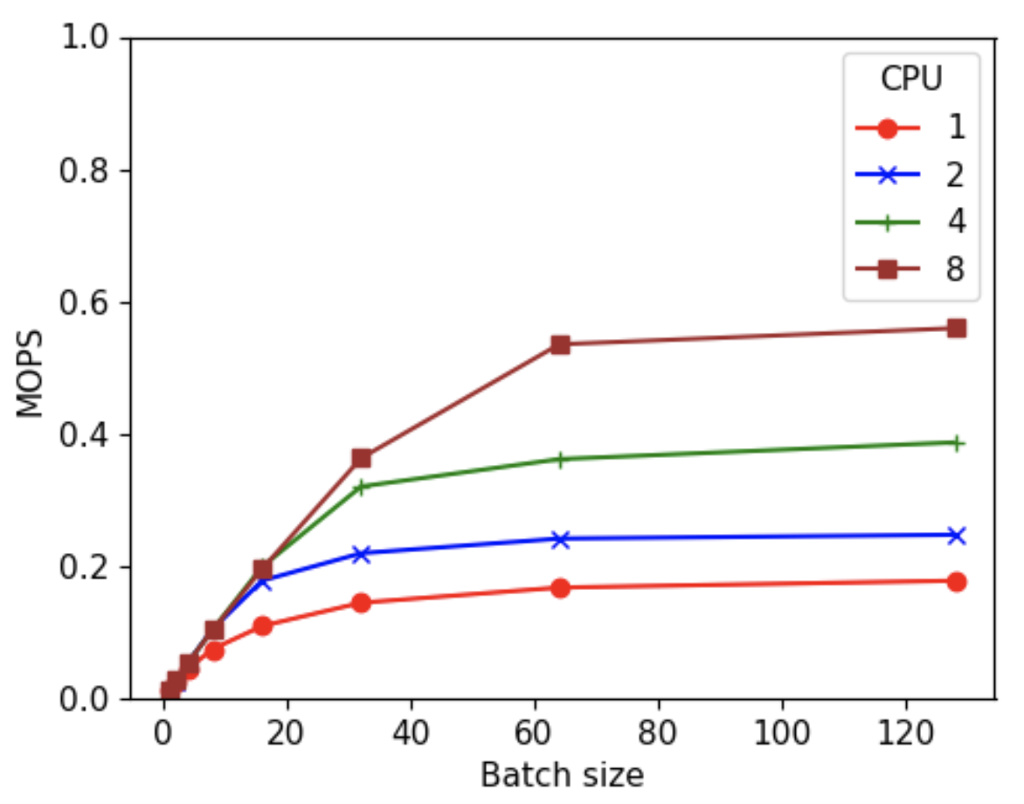
Requirements for Tiering
Page migration
move_pages() migrates pages among nodes (in batches)
Nimble’s improvements to the above syscall (open-sourced!)
Nimble also adds a new syscall: exchange_pages() which speeds up bi-directional movement

Slide 27
Memory tiering library: One option
Register a big region with Userfaultfd
jemalloc page allocations from the region (same as Eden)
On zero-page faults, direct allocations with (modified) UFFD_COPY
Need to know what pages are registered and where they reside
There won’t be any other page faults; how can we avoid Userfaultfd?
Page migration using move_pages()/exchange_pages()
What pages to move depends on policies we can build on later
I see no need for Shenango (so far)
Hiding latencies not possible nor necessary
Page migration throughput not a concern – we should be conservative with migration anyway because it cuts into CPU time and inter-tier bandwidth

